Slide 1

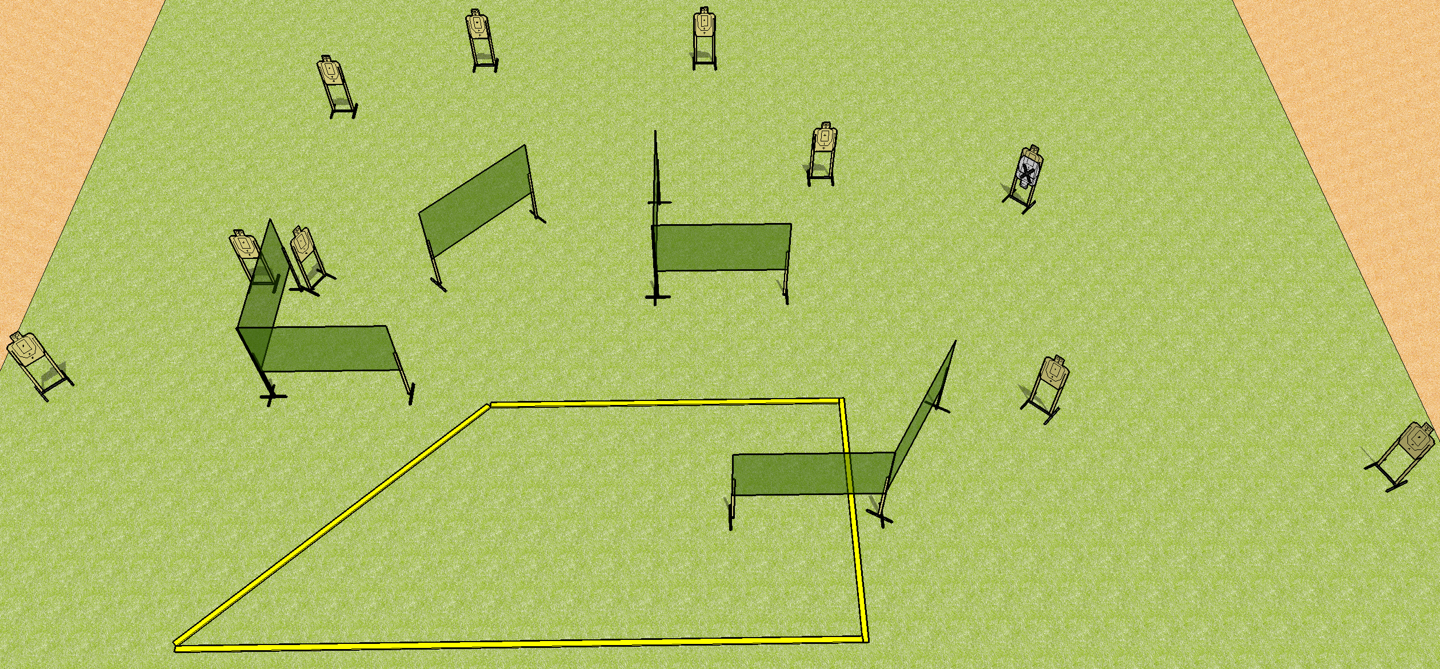
 | Dothan Practical Shooters – USPSA Match Don’t Forget To Fire 3 Course Designer : Drew Coleman Bay: B3
Round Count 30 rounds 10 USPSA
Equipment List 12 wall feet
20’
20’

Slide 2
Don’t Forget To Fire 3
Written Stage Briefing
Scoring: Comstock Rounds: 30
Targets: 10 USPSA, best 3 per target
Handgun start position: anywhere inside the shooting area, wrists below belt. Handgun is loaded and holstered.
PCC start position: anywhere inside the shooting area, stock on belt. Loaded carbine is held with both hands, safety on.
Stage Procedure: on the audible start signal, engage targets as they become available from within the shooting area.

